Slide 1
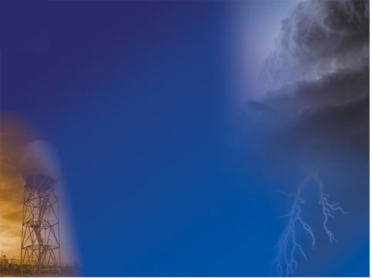
Georgia Regional Elementary Science Olympiad
Weather or Not

Slide 2
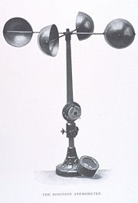
What is the name of this device?
What does it measure?

Slide 3
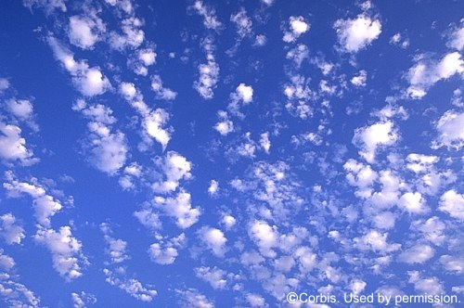
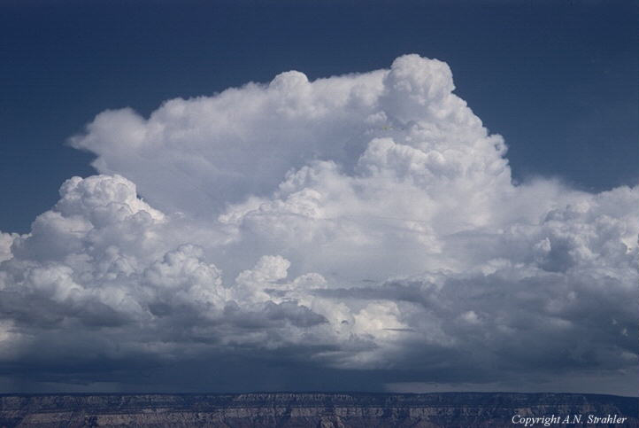
A. Altostratus
B. Cirrocumulus
C. Cirrostratus
D. Cirrus
E. Cumulus
F. Cumulonimbus
G. Nimbostratus
H. Nimbus
I. Stratus
Match a cloud name to the clouds pictured. Not all words will be used.
3
4
5

Slide 4
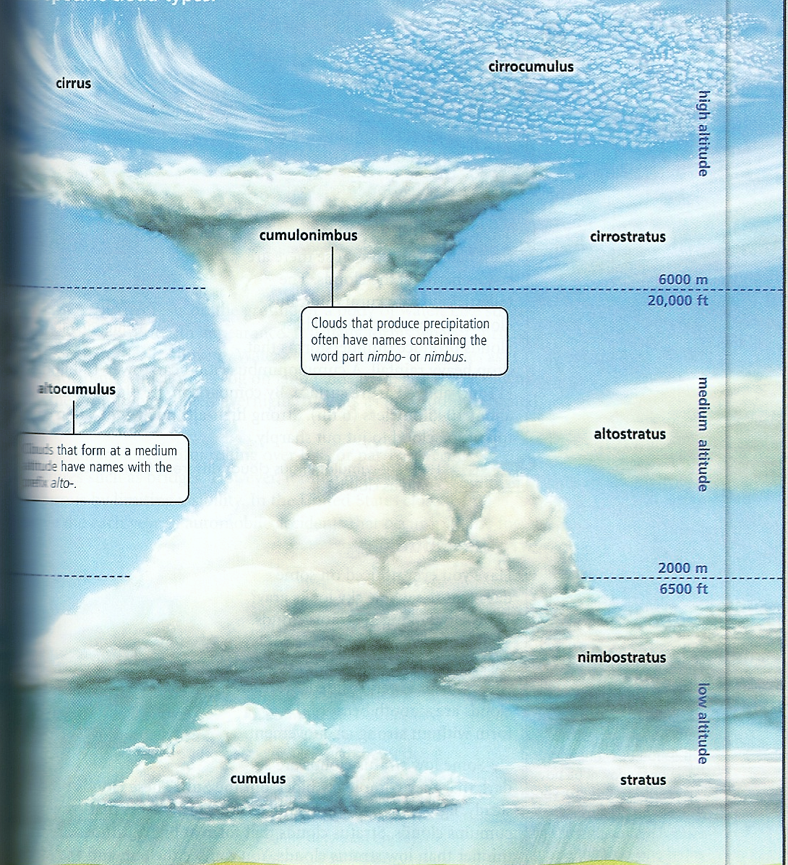
6
7
8
9
10
11
Altocumulus
Altostratus
C. Cirrocumulus
D. Cirrostratus
E. Cirrus
F. Cumulus
G. Cumulonimbus
H. Nimbostratus
I. Stratus
12
13
14

Slide 5
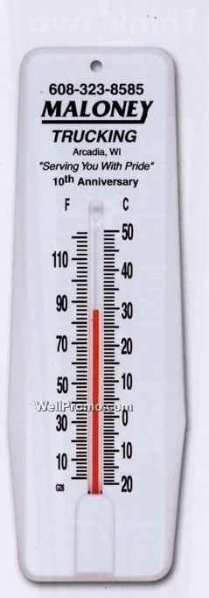
What is the name of this weather instrument?
Record the temperature in degrees Fahrenheit.
Record the temperature in degrees Celsius.

Slide 6
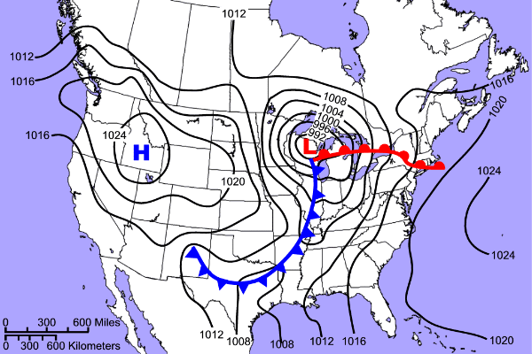
B
F
E
D
A
C
Use the map above, and the locations marked A-F, to answer the following questions.
18. The center of a low pressure system would be found at which location? ________
19. At which location(s) would you expect to see precipitation? __________
20. What is atmospheric pressure at location A? _____________
21. What is the atmospheric pressure at location B?___________
22. What is the proper name for the contour lines on the map?_________________
23. Which two locations would you expect to have the warmest temperatures? __________
24. Which location would you expect to have the lowest temperatures?__________
25. Which location would be most likely to experience the highest wind speeds?_________

Slide 7
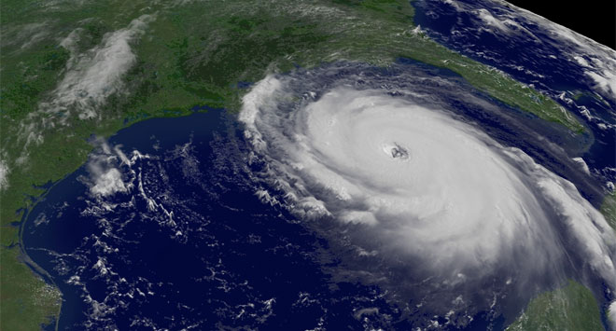
26. What is this a satellite image of?

Slide 8
What is the difference
between a hurricane, a
tropical cyclone and a
typhoon?

Slide 9
Regional ESO Answers
30 possible total points
Time can be a tie breaker

Slide 10
Anemometer 21. 1024+ millibars
Wind speed 22. Isobars
B 23. C, D (two points)
F 24. B
E 25. F
E 26. hurricane
C 27. Nothing. They are all three the same
G but differ in their location.
D
A
B
H
F
I
Thermometer
86 degrees F
29 degrees C
F
A, E, F (worth three points)
1008-1012 millibars

